Slide 1
Modern Data Estate & Advanced Analytics
Sashank Pappu
Azure Data & AI Specialist

Slide 2


Sashank Pappu
Azure Data & AI Specialist.
Certified from MIT on ‘Advanced Analytics and Big Data Challenges’. Technology Enthusiast and Data Specialist. Certified Designer in Computer Vision
• Microsoft Certified Azure Data Architect. • Microsoft Certified Azure Machine Learning Developer • Certified on Practical Data Analytics with Microsoft Cortana Intelligence Suite.
10+ years of total experience as Data Specialist and Data Engineer.
Certifications
Experience
Currently working as Data Consultant on Azure Data & AI and Enterprise Trainer on Azure Data Analytics , Intelligence Suite and Cognitive Sciences
Expert facilitator and corporate behavioral trainer with 7 years of experience in designing programs, content development , Data Analytics and Machine Learning.
Role
Training
Sri Nag Sashank
Co-Founder & CTO – antz.ai

Slide 3




The session will span for 5 days & it is mandatory to attend all the days.
Self-Paced labs have been developed & access will be shared during the session.
The audience can participate in the leaning. However, it DOES NOT come with “Azure Subscriptions” & request users to arrange on their own.
A proctor will be available to take your queries via “Chat” window. Kindly “MUTE” and do not disturb the presenter.
The sessions are recorded. Will be made available through LMS at the end of series.
Note: More trainings on the same & similar topics would be delivered in near future. Keep your options open.
Guidelines for the event

Slide 4
What we will learn
Day | Topics
Day 1 | Explore, transform, and load data into the Data Warehouse using Apache Spark
Day 2 | Azure Databricks & Delta Lake Streaming
Day 3 | Transform data with Azure Data Flows or Azure Synapse Pipelines
Day 4 | Integrate data from notebooks with Azure Data Factory or Azure Synapse Pipelines Build reports using Power BI integration with Azure Synapse Analytics
Day 5 | End-to-end security with Azure Synapse Analytics
Challenge | End-to-End data analytics solution using Azure Synapse Analytics

Slide 5

Further more
What we will learn in next 5 days

Slide 6
Day 1
Perform
Perform Data Exploration in Synapse Studio
Ingest
Ingest data with Spark notebooks in Azure Synapse Analytics
Transform
Transform data with DataFrames in Spark pools in Azure Synapse Analytics
Integrate
Integrate SQL and Spark pools in Azure Synapse Analytics

Slide 7
Day 2
Understand Databricks & Delta Lake
Hands-On Delta Lake Architecture
Central Delta Lake
Delta Lake Zones Creation.
Streaming Data Management.

Slide 8
Day 3
Execute code-free transformations at scale with Azure Synapse Pipelines
1
Create data pipeline to import poorly formatted CSV files
2
Create Mapping Data Flows
3

Slide 9
Day 4
Data movement in Azure Synapse Pipelines
Transformation in Azure Synapse Pipelines
Integrate a Synapse workspace and Power BI
Optimize integration with Power BI
Improve query performance
Visualize data with SQL serverless and create a Power BI report

Slide 10
Day 5
Secure Azure Synapse Analytics supporting infrastructure
Secure the Azure Synapse Analytics workspace and managed services
Secure Azure Synapse Analytics workspace data
Lab Challenge

Slide 11
Overview
Agenda

Slide 12
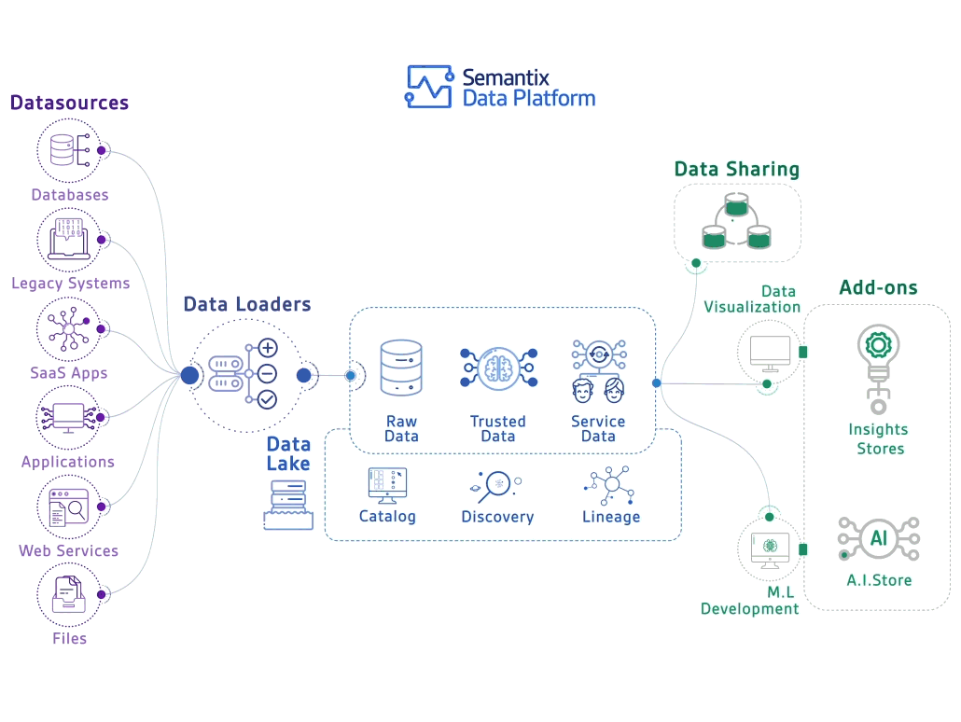

Slide 13

I tried to understand the modern data warehouse on my own…
And felt like I was body slammed by Randy Savage:
Let’s prevent that from happening…

Slide 14




Slide 15


Slide 16





LOB
CRM
BI + Reporting
INGEST
STORE
PREP
MODEL & SERVE
(& store)
Graph
Advanced Analytics
Image
Social
Data orchestration and monitoring
Big data store
Transform & Clean
Data warehouse
AI
IoT
Azure Data Factory
SSIS
Azure Data Lake Storage Gen2
Blob Storage
Azure Data Lake Storage Gen1
SQL Server 2019 Big Data Cluster
Azure Databricks
Azure HDInsight
PolyBase & Stored Procedures
Power BI Dataflow
Azure SQL Data Warehouse
Azure Analysis Services
SQL Database (Single, MI, HyperScale, Serverless)
SQL Server in a VM
Azure Data Lake Analytics Cosmos DB
Power BI Aggregations

Slide 17
Questions to ask customer
Can you use the cloud?
Is this a new solution or a migration?
What is the skillset of the developers?
Will you use non-relational data (variety)?
How much data do you need to store (volume)?
Is this an OLTP or OLAP/DW solution?
Will you have streaming data (velocity)?
Will you use dashboards and/or ad-hoc queries?
Will you use batch and/or interactive queries?
How fast do the operational reports need to run?
Will you do predictive analytics?
Do you want to use Microsoft tools or open source?
What are your high availability and/or disaster recovery requirements?
Do you need to master the data (MDM)?
Are there any security limitations with storing data in the cloud?
Does this solution require 24/7 client access?
How many concurrent users will be accessing the solution at peak-time and on average?
What is the skill level of the end users?
What is your budget and timeline?
Is the source data cloud-born and/or on-prem born?
How much daily data needs to be imported into the solution?
What are your current pain points or obstacles (performance, scale, storage, concurrency, query times, etc)?
Are you ok with using products that are in preview?

Slide 18


Slide 19
LOB
CRM
BI + Reporting
INGEST
STORE
PREP
MODEL & SERVE
(& store)
Graph
Advanced Analytics
Image
Social
Data orchestration and monitoring
Big data store
Transform & Clean
Data warehouse
AI
IoT
Azure Data Factory
SSIS
Azure Data Lake Storage Gen2
Blob Storage
Azure Data Lake Storage Gen1
SQL Server 2019 Big Data Cluster
Azure Databricks
Azure HDInsight
PolyBase & Stored Procedures
Power BI Dataflow
Azure SQL Data Warehouse
Azure Analysis Services
SQL Database (Single, MI, HyperScale, Serverless)
SQL Server in a VM
Azure Data Lake Analytics Cosmos DB
Power BI Aggregations

Slide 20













Slide 21










Slide 22



Slide 23
LOB
CRM
INGEST
Data orchestration and monitoring
STORE Big data store | PREP Transform & Clean | MODEL & SERVE (& store) Data warehouse
Azure Data Lake Storage Gen2 Blob Storage Azure Data Lake Storage Gen1 SQL Server 2019 Big Data Cluster
BI + Reporting
Graph
Advanced Analytics
Image
Social
AI
IoT
Azure Data Factory
SSIS
Azure Databricks
Azure HDInsight
PolyBase & Stored Procedures
Power BI Dataflow
Azure SQL Data Warehouse
Azure Analysis Services
SQL Database (Single, MI, HyperScale, Serverless)
SQL Server in a VM
Azure Data Lake Analytics Cosmos DB
Power BI Aggregations

Slide 24









Slide 25



non-analytical use cases that only need object storage rather than hierarchical storage

Slide 26
Zone 1
Zone 2
Zone 3
LRS
Multiple replicas across a datacenter
Protect against disk, node, rack failures
Write is ack’d when all replicas are committed
Superior to dual-parity RAID
11 9s of durability
SLA: 99.9%
ZRS
GRS
RA-GRS
Replicas across 3 Zones
Protect against disk, node, rack and zone failures
Synchronous writes to all 3 zones
12 9s of durability Available in 8 regions SLA: 99.9%
Multiple replicas across each of 2 regions
Protects against major regional disasters
Asynchronous to secondary 16 9s of durability
SLA: 99.9%
GRS + Read access to secondary Separate secondary endpoint
RPO delay to secondary can be queried
SLA: 99.99% (read), 99.9% (write)

Slide 27


Slide 28







updateable distributed tables and replicated dimensional tables). We now have HDFS on-prem version. Both SQL and Spark can access same data. Great if you are already a SQL shop

Slide 29


Slide 30
LOB
CRM
BI + Reporting
INGEST
STORE
PREP
MODEL & SERVE
(& store)
Graph
Advanced Analytics
Image
Social
Data orchestration and monitoring
Big data store
Transform & Clean
Data warehouse
AI
IoT
Azure Data Factory
SSIS
Azure Data Lake Storage Gen2
Blob Storage
Azure Data Lake Storage Gen1
SQL Server 2019 Big Data Cluster
Azure Databricks
Azure HDInsight
PolyBase & Stored Procedures
Power BI Dataflow
Azure Data Lake Analytics
Azure SQL Data Warehouse
Azure Analysis Services
SQL Database (Single, MI, HyperScale, Serverless)
SQL Server in a VM Cosmos DB
Power BI Aggregations

Slide 31






















Slide 32

Databricks is the preferred product over HDI, unless the customer has a mature Hadoop ecosystem already established, wants to be 100% open source, wants to use other Hadoop tools that are available 24/7 at a lower cost, or wants to use other tools like Kafka/Storm/HBase/R Server/LLAP/Hive/Pig
always running and incurring costs (no pausing or auto scale). Hortonworks merged with Cloudera

Slide 33





Stick with T-SQL and don’t want to deal with Spark or Hive or other more-difficult technologies

Slide 34





Integrates data lake and data prep technology (Power Query) directly into Power BI Service, independent of PBI reports. Self-service data prep
Individual solution or for small workloads. Data Analysts and Business Analysts. Can transform data that lands in the data lake and can then be used as part of an enterprise solution

Slide 35



transforming large amounts of data in a data lake or replacing long-running monthly batch processing with shorter running distributed processes. Predictable performance with no startup time
Does not support interactive
queries, persistence, or indexing

Slide 36



Slide 37
LOB
CRM
BI + Reporting
INGEST
STORE
PREP
MODEL & SERVE
(& store)
Graph
Advanced Analytics
Image
Social
Data orchestration and monitoring
Big data store
Transform & Clean
Data warehouse
AI
IoT
Azure Data Factory
SSIS
Azure Data Lake Storage Gen2
Blob Storage
Azure Data Lake Storage Gen1
SQL Server 2019 Big Data Cluster
Azure Databricks
Azure HDInsight
PolyBase & Stored Procedures
Power BI Dataflow
Azure Data Lake Analytics
Azure SQL Data Warehouse
Azure Analysis Services
SQL Database (Single, MI, HyperScale, Serverless)
SQL Server in a VM Cosmos DB
Power BI Aggregations

Slide 38













SQL-based, fully-managed, petabyte-scale cloud data warehouse.
Can scale compute and storage independently allowing you to burst compute, and c
MPP technology that shines when used for ad-hoc queries and operational reports in relational format
equires data to be copied from ADLS into SQL DW but this can be done quickly using PolyBase

Slide 39



slower performance for ad-hoc queries
Area a

Slide 40













Slide 41




cases: Need control over / access to the operating system, have to run the app or agents side-by-side with the DB, need to use older version of SQL Server, SSRS, DW in the 4TB-50TB range, 3rd-party app not certified for PaaS, DBA afraid of losing his job, control over backups and maintenance window, want to avoid risk
How to use: IaaS. Provision

Slide 42






A globally distributed, multi-model (key-value, graph, and document) database service. It fits into the NoSQL camp by having a non- relational model (supporting schema-on-read and JSON documents)
Works really well for large-scale OLTP solutions.
for DW aggregations. Use for data lake to have one datastore for both operational and analytical queries

Slide 43



Slide 44






Slide 45


Artificial Intelligence Decision Tree Big Data Decision Tree v4
Business Intelligence Solutions Decision Tree

Slide 46


Slide 47


Slide 48
Microsoft data platform solutions
Product | Category | Description | More Info
SQL Server 2017 | RDBMS | Earned top spot in Gartner’s Operational Database magic quadrant. JSON support. Linux support | https://www.microsoft.com/en-us/server- cloud/products/sql-server-2017/
SQL Database | RDBMS/DBaaS | Cloud-based service that is provisioned and scaled quickly. Has built-in high availability and disaster recovery. JSON support. Managed Instance option | https://azure.microsoft.com/en- us/services/sql-database/
SQL Data Warehouse | MPP RDBMS/DBaaS | Cloud-based service that handles relational big data. Provision and scale quickly. Can pause service to reduce cost | https://azure.microsoft.com/en- us/services/sql-data-warehouse/
Azure Data Lake Store | Hadoop storage | Removes the complexities of ingesting and storing all of your data while making it faster to get up and running with batch, streaming, and interactive analytics | https://azure.microsoft.com/en- us/services/data-lake-store/
HDInsight | PaaS Hadoop compute/Hadoop clusters-as-a-service | A managed Apache Hadoop, Spark, R Server, HBase, Kafka, Interactive Query (Hive LLAP) and Storm cloud service made easy | https://azure.microsoft.com/en- us/services/hdinsight/
Azure Databricks | PaaS Spark clusters | A fast, easy, and collaborative Apache Spark based analytics platform optimized for Azure | https://databricks.com/azure
Azure Data Lake Analytics | On-demand analytics job service/Big Data-as-a- service | Cloud-based service that dynamically provisions resources so you can run queries on exabytes of data. Includes U- SQL, a new big data query language | https://azure.microsoft.com/en- us/services/data-lake-analytics/
Azure Cosmos DB | PaaS NoSQL: Key-value, Column-family, Document, Graph | Globally distributed, massively scalable, multi-model, multi- API, low latency data service – which can be used as an operational database or a hot data lake | https://azure.microsoft.com/en- us/services/cosmos-db/
Azure Database for PostgreSQL, MySQL, and MariaDB | RDBMS/DBaaS | A fully managed database service for app developers | https://azure.microsoft.com/en- us/services/postgresql

Slide 49





A z u r e D a t a L a k e S t o r a g e G e n 2
A “no-compromises” Data Lake: secure, performant, massively-scalable Data Lake storage that brings the cost and scale profile of object storage together with the performance and analytics feature set of data lake storage
S E C U R E
M A N A G E A B L E
F A S T
S C A L A B L E
C O S T
E F F E C T I V E
I N T E G R A T I O N R E A D Y
Support for fine- grained ACLs, protecting data at the file and folder level
Multi-layered protection via at-rest Storage Service encryption and Azure Active Directory integration
Automated Lifecycle Policy Management
Atomic file operations means jobs complete faster
No limits on data store size
Object store pricing levels
Optimized for Spark and Hadoop Analytic Engines
Global footprint (50 regions)
File system operations minimize transactions required for job completion
Object Level
tiering
Tightly integrated with Azure end to end analytics solutions

Slide 50
Integrating all data
Managing all data
Managed data lake with SQL Server and Spark
AI over all data
Complete AI platform
Data virtualization
Analytics
Apps
Admin portal and management services Integrated AD-based security
T-SQL
REST API containers for models
SQL Server External Tables
SQL
Server
Spark
SQL Server ML Services
Spark & Spark ML
Compute pools and data pools
Scalable, shared storage (HDFS)
Open database connectivity
NoSQL
Relational databases
HDFS
External data sources
HDFS
Combine data from many sources without moving or replicating it
Scale out compute and caching to boost performance
Store high volume data in a data lake and access it easily using either SQL or Spark
Management services, admin portal, and integrated security make it all easy to manage
Easily feed integrated data from many sources to your model training
Ingest and prep data and then train, store, and operationalize your models all in one system
Intelligence over all data

Slide 51



Increase analytics and apps performance
Custom apps
BI
Analytics
SQL
SQL Server master instance
Compute pool
Compute pool
Compute pool
Directly read from HDFS
SQL Compute Node
SQL Compute Node
SQL Compute Node
SQL Compute Node
…
SQL Compute Node
Data pool
Storage pool
SQL Data Node
Storage
SQL Data Node
Storage
Spark
SQL
Server
Spark |  |  | SQL Server
HDFS Data Node
Spark |  |  | SQL Server
HDFS Data Node
…
HDFS Data Node
IoT data
Kubernetes pod
Node Node Node Node Node
Node Node
Persistent storage
Intelligence over all data

Slide 52







Slide 53



Programming Model | General Purpose | Business Critical | Hyperscale | Elastic Pools
Instance (MI) | GA, 8TB | GA, 4TB | Private Preview, 100TB | April private preview
Database (Single) | GA, 4TB [Serverless] | GA, 4TB | Public Preview, 100TB | GA

Slide 54



















Power BI Self-service data prep Dataflows AI consumption Enterprise BI Semantic models Self-service BI | Azure Data Factory Data ingestion & orchestration | Azure Databricks Enterprise data prep | Azure SQL DW Curated data
Contact Lead Opportunity Account Customer Profile Product Profile People Profile

Slide 56
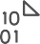


C L O U D
D A T A
W A R E H O U S E
INGEST
STORE
PREP & TRAIN
MODEL & SERVE
Logs (unstructured)
Media (unstructured)
PolyBase
Files (unstructured)
Azure Data Factory
Azure Data Lake Store Gen2
Azure SQL Data Warehouse
Azure Analysis Services
Power BI
Business/custom apps
(structured)
Microsoft Azure also supports other Big Data services like Azure HDInsight to allow customers to tailor the above architecture to meet their unique needs.

Slide 57
M O D E R N
D A T A
W A R E H O U S E
INGEST
STORE
PREP & TRAIN
MODEL & SERVE
Logs (unstructured)
Azure Databricks
Media (unstructured)
PolyBase
Files (unstructured)
Azure Data Factory
Azure Data Lake Store Gen2
Azure SQL Data Warehouse
Azure Analysis Services
Power BI
Business/custom apps
(structured)
Microsoft Azure also supports other Big Data services like Azure HDInsight to allow customers to tailor the above architecture to meet their unique needs.

Slide 58



A D V A N C E D A N A L Y T I C S O N B I G D A T A
INGEST
STORE
PREP & TRAIN
MODEL & SERVE
Logs (unstructured)
Azure Databricks
SparkR
Cosmos DB
Real-time apps
Media (unstructured)
PolyBase
Files (unstructured)
Azure Data Factory
Azure Data Lake Store Gen2
Azure SQL Data Warehouse
Azure Analysis Services
Power BI
Business/custom apps
(structured)
Microsoft Azure also supports other Big Data services like Azure HDInsight, Azure Machine Learning to allow customers to tailor the above architecture to meet their unique needs.

Slide 59




R E A L
T I M E
A N A L Y T I C S
INGEST
STORE
PREP & TRAIN
MODEL & SERVE
Sensors and IoT (unstructured)
Azure Databricks
Logs (unstructured)
Apache Kafka for HDInsight
Cosmos DB
Real-time apps
Media (unstructured)
Files (unstructured)
PolyBase
Business/custom apps (structured)
Azure Data Factory
Azure Data Lake Store Gen2
Azure SQL Data Warehouse
Azure Analysis Services
Power BI
Microsoft Azure also supports other Big Data services like Azure IoT Hub, Azure Event Hubs, Azure Machine Learning to allow customers to
tailor the above architecture to meet their unique needs.

Slide 60





D A T A
M A R T
C O N S O L I D A T I O N
INGEST
STORE
MODEL & SERVE
PolyBase
RDBMS data marts
Azure Data Factory
Azure Data Lake Store Gen2
Azure SQL Data Warehouse
Azure Analysis Services
Power BI
Hadoop
Microsoft Azure also supports other Big Data services like Azure HDInsight to allow customers to tailor the architecture to meet their unique needs.

Slide 61



H U B & S P O K E A R C H I T E C T U R E F O R B I
INGEST
STORE
PREP & TRAIN
MODEL & SERVE
Data Marts
SQL
Multiple Azure SQL Database instances
Business/custom apps (structured)
Azure Databricks
Logs (unstructured)
PolyBase
Azure Data Factory
Azure Data Lake Store Gen2
Azure SQL Data Warehouse
Power BI
Media (unstructured)
Data Cubes
Multiple Azure Analysis Services instances
Files (unstructured)
Microsoft Azure supports other services like Azure HDInsight to allow customers a truly customized solution.

Slide 62
A U T O
S C A L I N G
D A T A
W A R E H O U S E
INGEST
STORE
PREP & TRAIN
MODEL & SERVE
Business/custom apps (structured)
Azure Databricks
Logs (unstructured)
PolyBase
Azure Data Factory
Azure Data Lake Store Gen2
Azure SQL Data Warehouse
Azure Analysis Services
Power BI
Media (unstructured)
Azure Functions (Auto-scaling)
Files (unstructured)
Microsoft Azure supports other services like Azure HDInsight to allow customers a truly customized solution.

Slide 63



D A T A
W A R E H O U S E
M I G R A T I O N
INGEST
STORE
PREP & TRAIN
MODEL & SERVE
Business/custom apps (structured)
PolyBase
Azure SQL Data Warehouse
Business/custom apps
Logs (unstructured)
Azure Analysis Services
Media (unstructured)
Azure Data Factory
Azure Data Lake Store Gen2
Azure Databricks
Power BI
Files (unstructured)
Azure also supports other Big Data services like Azure HDInsight to allow customers to tailor the architecture to meet their unique needs.

Slide 64
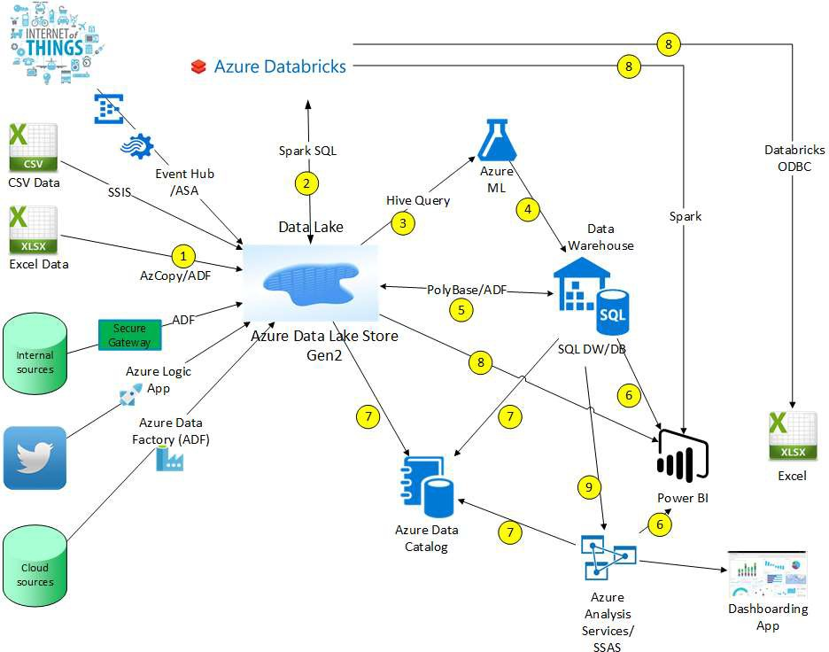

Slide 65








Slide 66
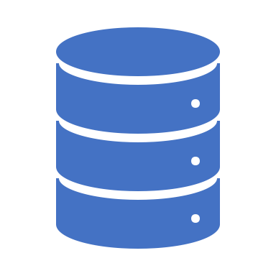
Introduction to SQL Serverless

Slide 67





Serverless SQL Pool
Overview
An interactive query service that provides T-SQL queries over high scale data in Azure Storage.
Benefits
Pay-per-query with serverless model
Query data in-place on the data lake with T-SQL (no ETL)
Supports various file formats (Parquet, CSV, JSON)
Integrates with Databricks, HDInsight, PowerBI, and the shared Synapse metastore
Power BI
Curate and transform data
SQL On Demand Query
Azure Data Studio
Sync table definitions
Read and write
data files
SSMS
Read and write
data files
10
01
Azure Storage

Slide 68
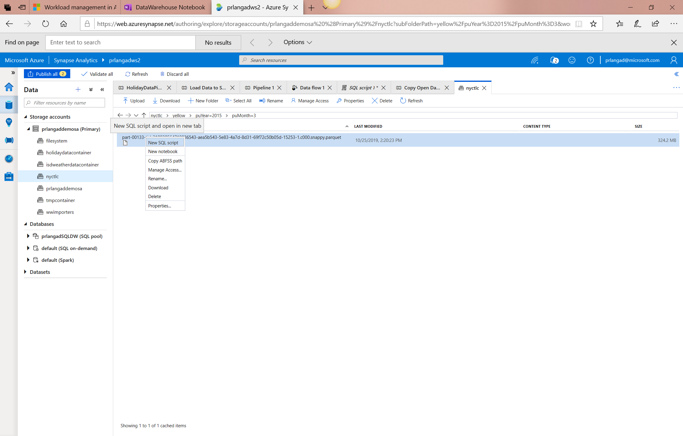
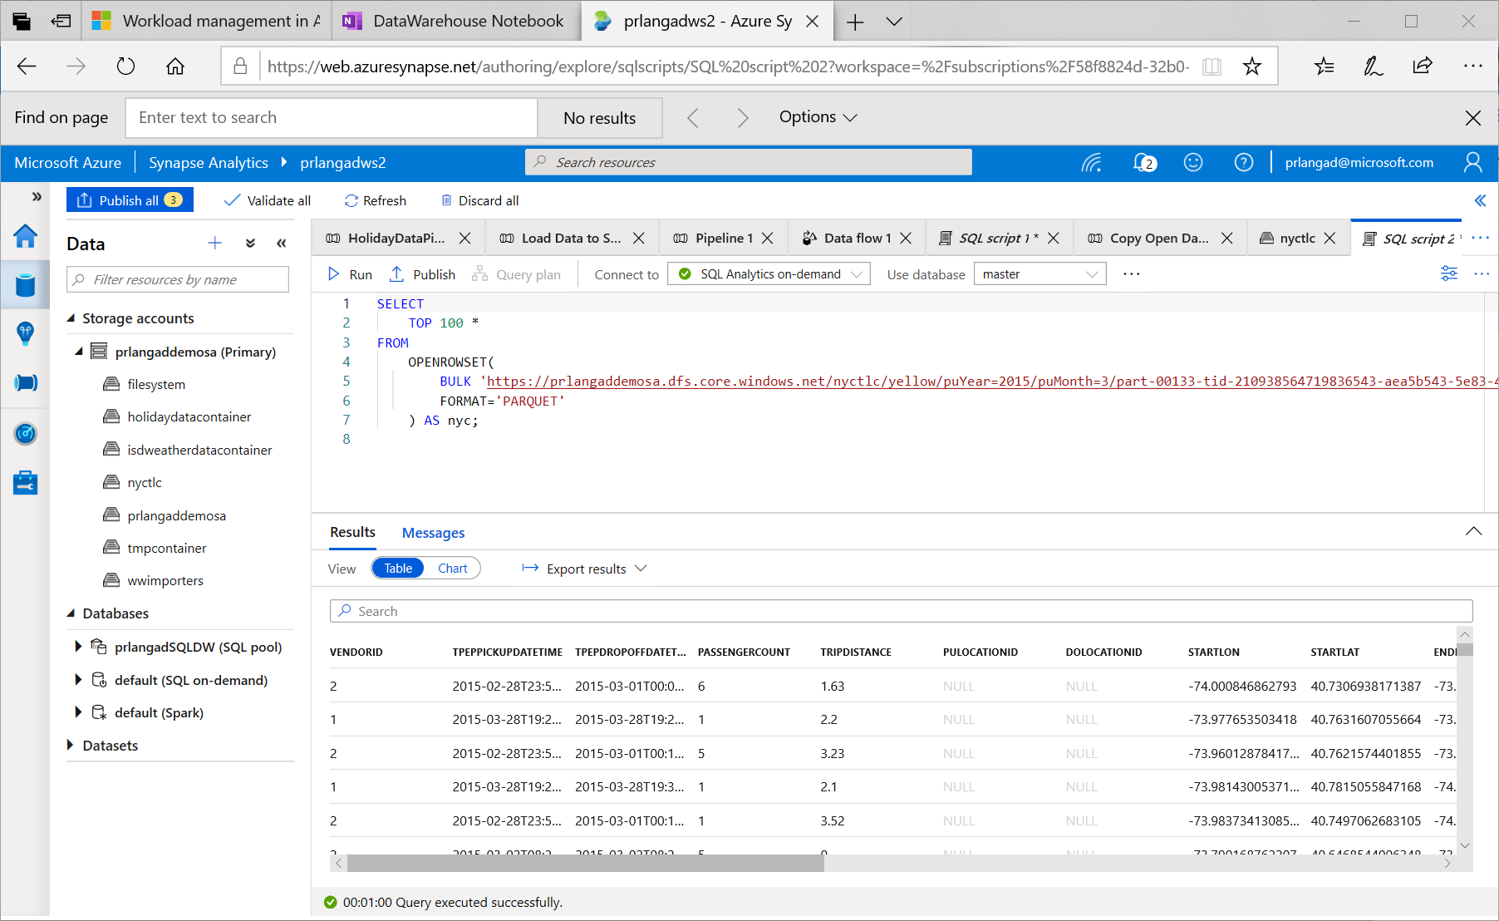
Serverless SQL – Querying on storage

Slide 69
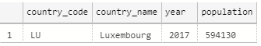
Serverless SQL – Querying CSV File
Overview
Uses OPENROWSET function to access data
Benefits
Ability to read CSV File with
- no header row, Windows style new line
- no header row, Unix-style new line
- header row, Unix-style new line
- header row, Unix-style new line, quoted
- header row, Unix-style new line, escape
- header row, Unix-style new line, tab-delimited
- without specifying all columns
SELECT *
FROM OPENROWSET(
BULK 'https://XXX.blob.core.windows.net/csv/population/population.csv',
FORMAT = 'CSV',
FIELDTERMINATOR =',',
ROWTERMINATOR = '\n'
)
WITH (
[country_code] VARCHAR (5) COLLATE Latin1_General_BIN2,
[country_name] VARCHAR (100) COLLATE Latin1_General_BIN2,
[year] smallint,
[population] bigint
) AS [r]
WHERE
country_name = 'Luxembourg'
AND year = 2017

Slide 70
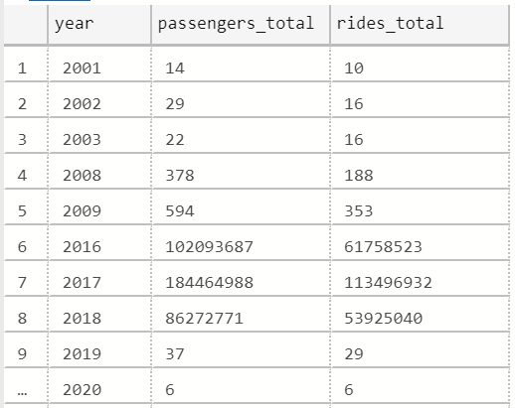
Serverless SQL – Querying folders
Overview
Uses OPENROWSET function to access data from
multiple files or folders
Benefits
Offers reading multiple files/folders through usage of wildcards
Offers reading specific file/folder
Supports use of multiple wildcards
SELECT YEAR(pickup_datetime) as [year], SUM(passenger_count) AS passengers_total, COUNT(*) AS [rides_total]
FROM OPENROWSET(
BULK 'https://XXX.blob.core.windows.net/csv/taxi/*.*’,
FORMAT = 'CSV’
, FIRSTROW = 2 )
WITH (
vendor_id VARCHAR(100) COLLATE Latin1_General_BIN2,
pickup_datetime DATETIME2,
dropoff_datetime DATETIME2,
passenger_count INT,
trip_distance FLOAT,
rate_code INT,
store_and_fwd_flag VARCHAR(100) COLLATE Latin1_General_BIN2,
pickup_location_id INT,
dropoff_location_id INT,
payment_type INT,
fare_amount FLOAT,
extra FLOAT, mta_tax FLOAT,
tip_amount FLOAT,
tolls_amount FLOAT,
improvement_surcharge FLOAT,
total_amount FLOAT
) AS nyc
GROUP BY YEAR(pickup_datetime)
ORDER BY YEAR(pickup_datetime)

Slide 71
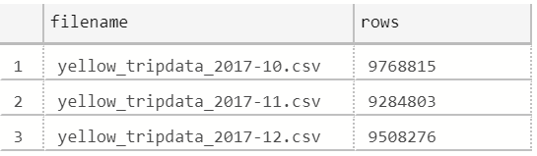
Serverless SQL – Querying specific files
Overview
filename – Provides file name that originates row result
filepath – Provides full path when no parameter is passed or part of path when parameter is passed that originates result
Benefits
Provides source name/path of file/folder for row result set
Example of filename function
SELECT
r.filename() AS [filename]
,COUNT_BIG(*) AS [rows]
FROM OPENROWSET(
BULK 'https://XXX.blob.core.windows.net/csv/taxi/yellow_tripdata_2017-1*.csv’,
FORMAT = 'CSV',
FIRSTROW = 2
)
WITH (
vendor_id INT,
pickup_datetime DATETIME2,
dropoff_datetime DATETIME2,
passenger_count SMALLINT,
trip_distance FLOAT,
<…columns>
) AS [r]
GROUP BY r.filename()
ORDER BY [filename]

Slide 72
Serverless SQL – Querying specific files
Example of filepath function
SELECT
r.filepath() AS filepath
,r.filepath(1) AS [year]
,r.filepath(2) AS [month]
,COUNT_BIG(*) AS [rows]
FROM OPENROWSET(
BULK 'https://XXX.blob.core.windows.net/csv/taxi/yellow_tripdata_*-*.csv’,
FORMAT = 'CSV',
FIRSTROW = 2 )
WITH (
vendor_id INT,
pickup_datetime DATETIME2,
dropoff_datetime DATETIME2,
passenger_count SMALLINT,
trip_distance FLOAT,
<… columns>
) AS [r]
WHERE r.filepath(1) IN ('2017’)
AND r.filepath(2) IN ('10', '11', '12’)
GROUP BY r.filepath() ,r.filepath(1) ,r.filepath(2)
ORDER BY filepath
filepath | year | month | rows
https://XXX.blob.core.windows.net/csv/taxi/yellow_tripdata_2017-10.csv | 2017 | 10 | 9768815
https://XXX.blob.core.windows.net/csv/taxi/yellow_tripdata_2017-11.csv | 2017 | 11 | 9284803
https://XXX.blob.core.windows.net/csv/taxi/yellow_tripdata_2017-12.csv | 2017 | 12 | 9508276

Slide 73
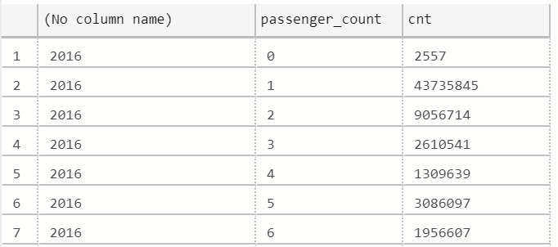
Serverless SQL – Querying Parquet files
Overview
Uses OPENROWSET function to access data
Benefits
Ability to specify column names of interest
Offers auto reading of column names and data types
Provides target specific partitions using filepath function
SELECT
YEAR(pickup_datetime),
passenger_count,
COUNT(*) AS cnt
FROM
OPENROWSET(
BULK 'https://XXX.blob.core.windows.net/parquet/taxi/*/*/*',
FORMAT='PARQUET'
) WITH (
pickup_datetime DATETIME2,
passenger_count INT
) AS nyc
GROUP BY
passenger_count,
YEAR(pickup_datetime)
ORDER BY
YEAR(pickup_datetime),
passenger_count

Slide 74
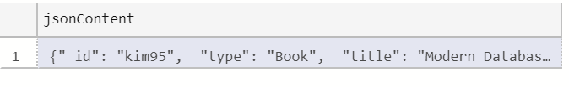
Serverless SQL – Querying JSON files
Overview
Read JSON files and provides data in tabular format
Benefits
Supports OPENJSON, JSON_VALUE and JSON_QUERY functions
SELECT *
FROM
OPENROWSET(
BULK 'https://XXX.blob.core.windows.net/json/books/book1.json’,
FORMAT='CSV',
FIELDTERMINATOR ='0x0b',
FIELDQUOTE = '0x0b',
ROWTERMINATOR = '0x0b'
)
WITH (
jsonContent varchar(8000)
) AS [r]

Slide 75
Serverless SQL – Querying JSON files
Example of JSON_VALUE function
Example of JSON_QUERY function
SELECT
JSON_VALUE(jsonContent, '$.title') AS title,
JSON_VALUE(jsonContent, '$.publisher') as publisher,
jsonContent
FROM
OPENROWSET(
BULK 'https://XXX.blob.core.windows.net/json/books/*.json',
FORMAT='CSV',
FIELDTERMINATOR ='0x0b',
FIELDQUOTE = '0x0b',
ROWTERMINATOR = '0x0b'
)
WITH (
jsonContent varchar(8000)
) AS [r]
WHERE
JSON_VALUE(jsonContent, '$.title') = 'Probabilistic and Statistical Methods in Cryptology, An Introduction by Selected Topics'
SELECT
JSON_QUERY(jsonContent, '$.authors') AS authors,
jsonContent
FROM
OPENROWSET(
BULK 'https://XXX.blob.core.windows.net/json/books/*.json',
FORMAT='CSV',
FIELDTERMINATOR ='0x0b',
FIELDQUOTE = '0x0b',
ROWTERMINATOR = '0x0b'
)
WITH (
jsonContent varchar(8000)
) AS [r]
WHERE
JSON_VALUE(jsonContent, '$.title') = 'Probabilistic and Statistical Methods in Cryptology, An Introduction by Selected Topics'

